Slide 1
Changes in Dietary Habits of Chinese Students in Russia
Group AP

Slide 2
Motivation & Objectives
01
Topic
Dietary Adaptation Analysis of Chinese Students in Russia.
02
Motivation
Drastic difference between Chinese and Russian cuisine (Veg-based vs. Meat/Dairy-based).
03
Goal
Quantify dietary changes and predict student adaptation using Self-Collected Data.
04
Approach
End-to-end workflow (Data Collection → Cleaning → EDA → Modeling).
Notes:
1. 研究背景：随着“一带一路”倡议，赴俄中国留学生数量激增，面临显著的跨文化挑战。
2. 核心问题：中俄饮食结构差异巨大（蔬菜/谷物 vs. 肉/奶制品），这种饮食冲击如何影响留学生的健康与心理适应？
3. 项目目标：不使用公开数据集，而是通过自主设计的问卷收集一手数据，利用全流程数据科学方法（End-to-End Workflow）量化分析这一适应过程。
"Welcome to our project. We focused on a real-world issue: how Chinese students adapt to the Russian diet. As we know, the food cultures are vastly different. Our motivation was not just to observe, but to quantify this impact. Instead of using off-the-shelf datasets, we conducted our own survey to build a unique dataset. Our goal is to analyze these dietary shifts and see if machine learning can predict how well a student adapts."

Slide 3
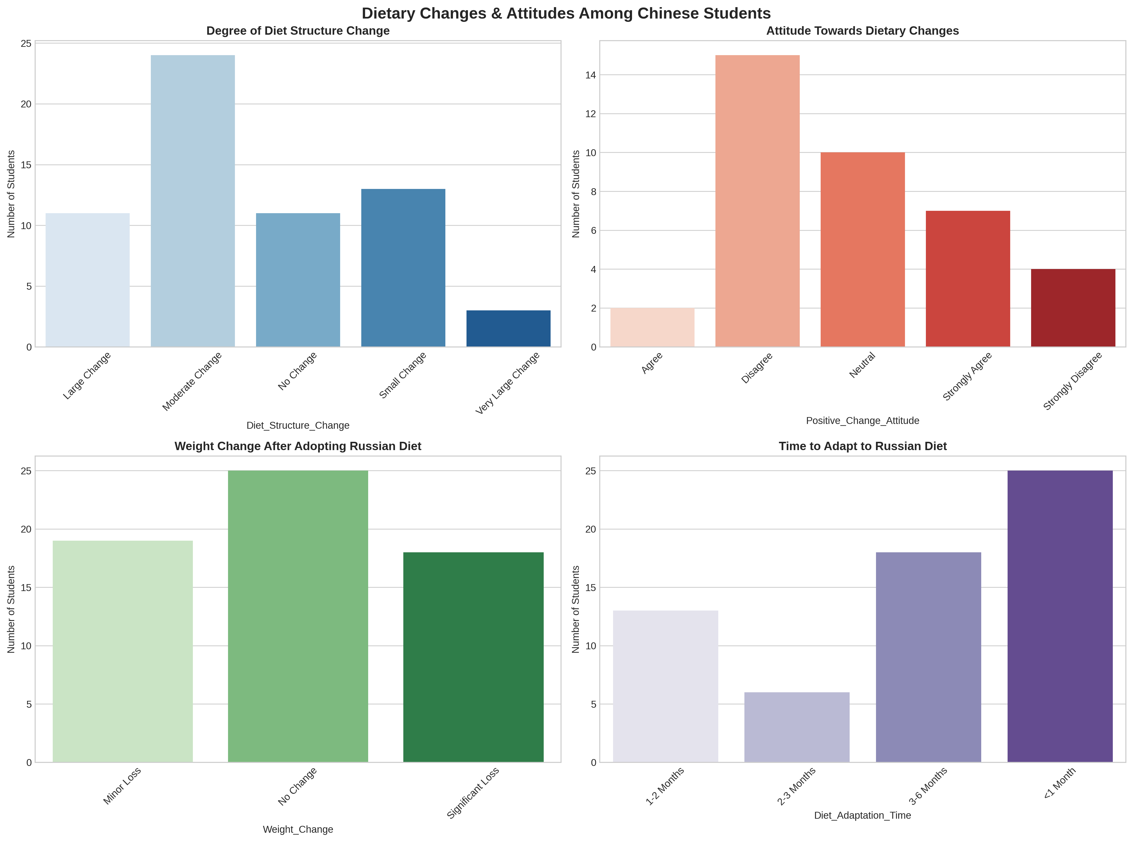
Demographics
Insight: A mature group of students, mostly in the early adaptation phase.
Sample Profile:
Gender: Balanced distribution (Male/Female).
Academic Grade: Majority are PhD students (Green bar) and Masters.
Duration: Most have stayed for 1-2 Years or <1 Year.
Notes:
1. 数据来源：自主收集的问卷数据（Self-collected Survey Data），涵盖不同背景的留俄学生。
2. 样本构成分析：学历分布以博士（PhD）和硕士为主，显示样本群体具有较高的学术背景；性别比例较为均衡（需解释图中 Label 1/2 代表的具体性别）；
留俄时长主要集中在 1-2 年及 1 年以下，正处于关键的适应期。
"Let's look at who we surveyed in Image 2. Our dataset covers a diverse group. As you can see in the bottom-left chart, the majority are PhD students, followed by Master's students. In terms of duration (bottom-right), most students have been in Russia for 1 to 2 years. This is the critical window for cultural adaptation, making them the perfect subjects for this study."

Slide 4
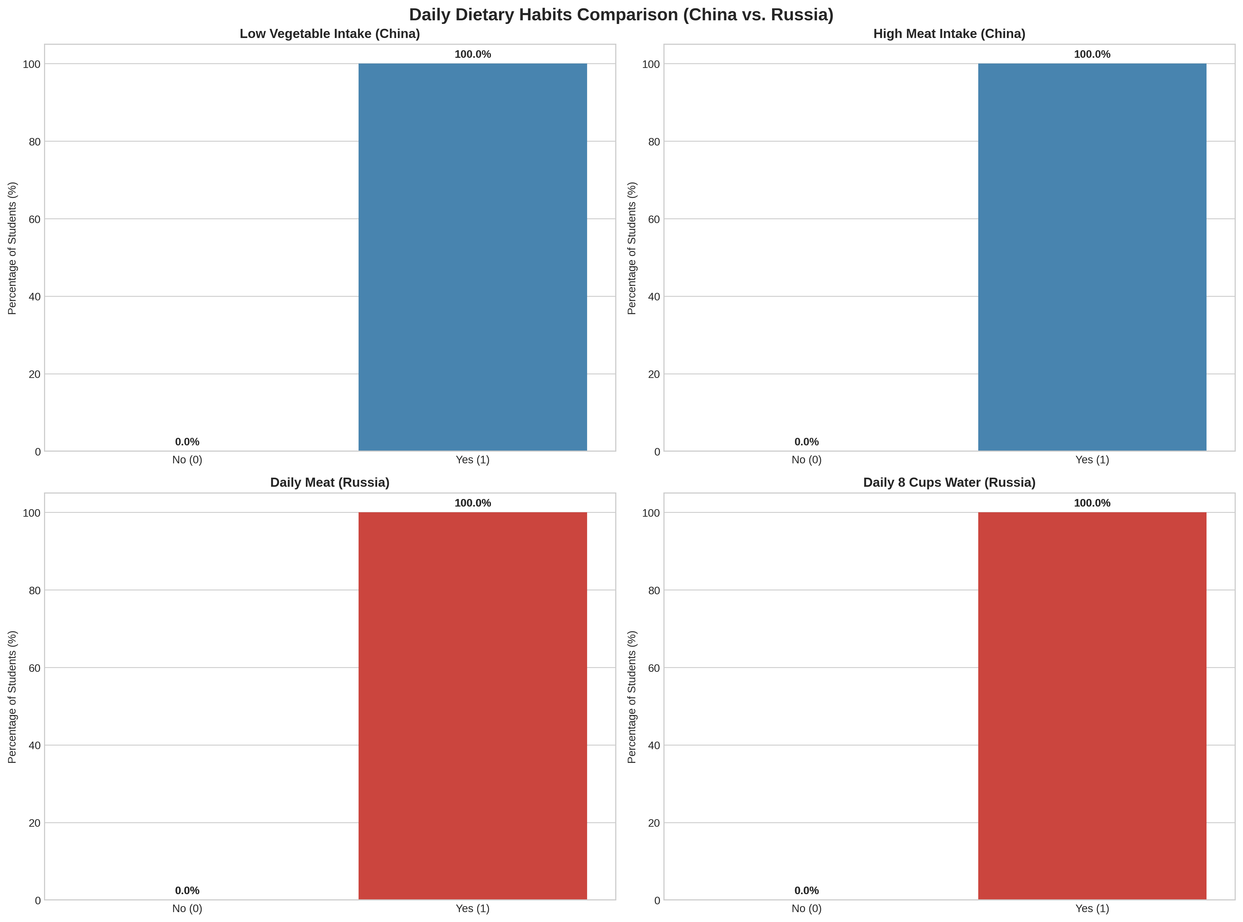
Data Engineering
Feature Engineering:
Data Cleaning Decision
Converted dietary frequencies into binary features (0/1).
Issue: Some features showed Zero Variance (e.g., 'Daily Meat (Russia)' = 100% Yes).
Action: Removed non-informative features to prevent model bias.
Focus
Ensuring data quality before modeling.
Notes:
1. 数据清洗：处理缺失值、异常值，并将模糊的问卷选项转化为计算机可理解的数值。
2. 特征二值化（Binary Encoding）：如图所示，我们将复杂的饮食习惯转化为二元特征（如“Daily Meat Intake: Yes/No”），这种转换虽然导致部分特征方差单一（如图中 100% 的分布），但也帮助我们识别出了样本中高度一致的饮食行为模式，为后续特征筛选提供了依据。
"Before analysis, we performed rigorous data engineering. Image 4 highlights a crucial step in our cleaning process. We noticed certain variables, like 'Daily Meat Intake in Russia,' had 100% 'Yes' responses. While this confirms the high-meat diet in Russia, mathematically, a feature with zero variance offers no information to a machine learning model. Therefore, we identified and removed these specific columns to improve our model's efficiency."

Slide 5
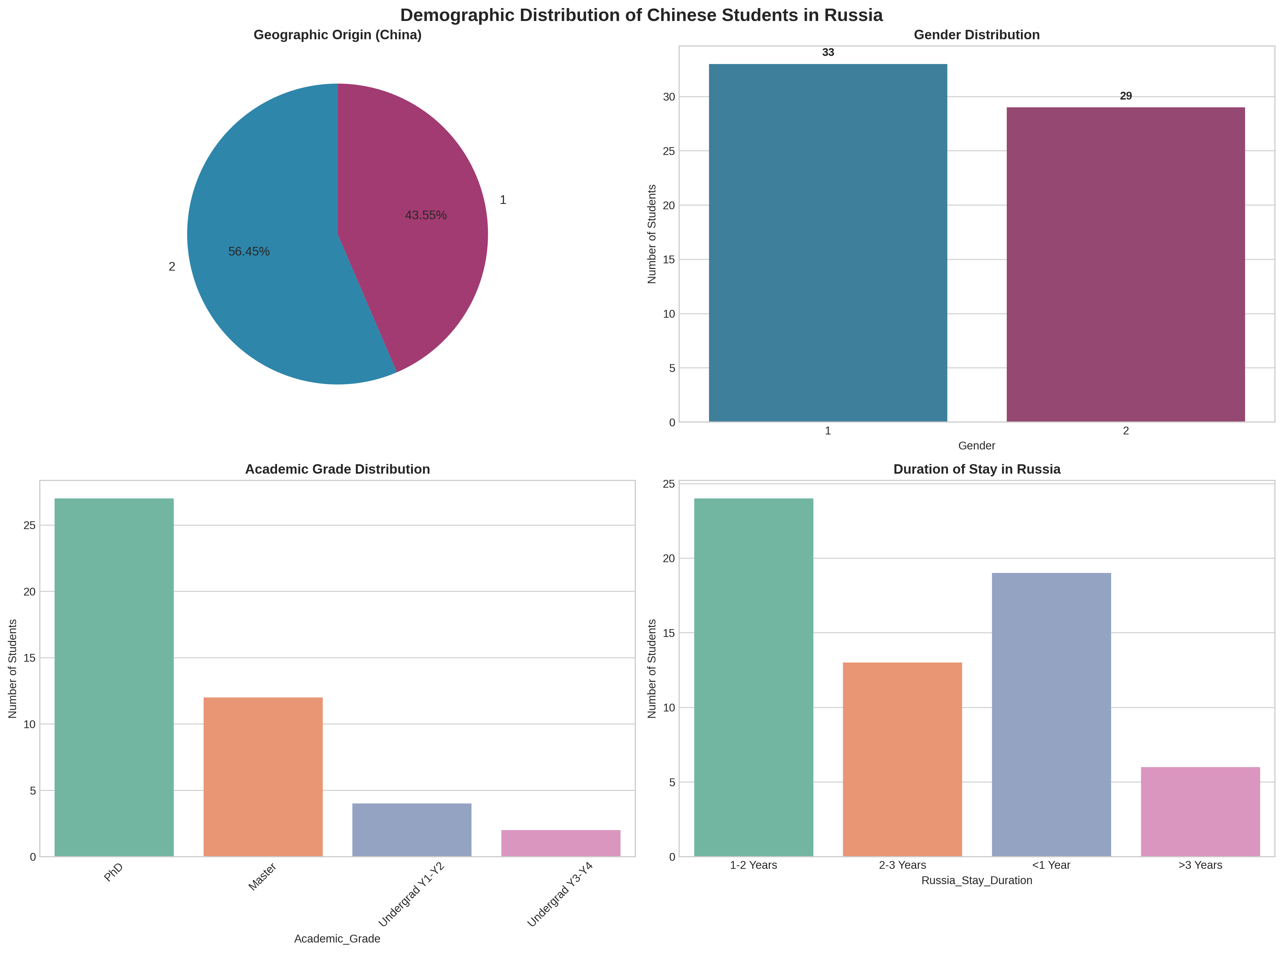
Dietary Comparison
Vegetables: Significant Trend → Minor Decrease & No Change.
Meat: Clear Trend → Minor Increase.
Fast Food: Notable Increase (Convenience factor).
Conclusion: The "Meat-heavy, Vegetable-light" stereotype is statistically confirmed.
Notes:
1. “蔬菜危机”：数据显示，大部分学生在俄期间蔬菜摄入量呈现“Minor Decrease”甚至更少，反映了当地蔬菜供应或饮食习惯的客观限制。
2. 肉类与快餐的增加：相比之下，快餐（Fast Food）的摄入量有明显上升趋势，肉类摄入虽然有波动，但在特定群体中依然保持高位。这量化了典型的“高热量、低纤维”饮食结构转变。
"Now for the core exploratory analysis in Image 1. This visualization confirms the dietary shift. Look at the top left: Vegetable consumption shows a clear downward trend. In contrast, the top right shows Meat consumption increasing. Also, note the Fast Food chart—consumption has gone up. This quantitatively confirms that students are indeed eating more meat and fast food while struggling to maintain vegetable intake."

Slide 6
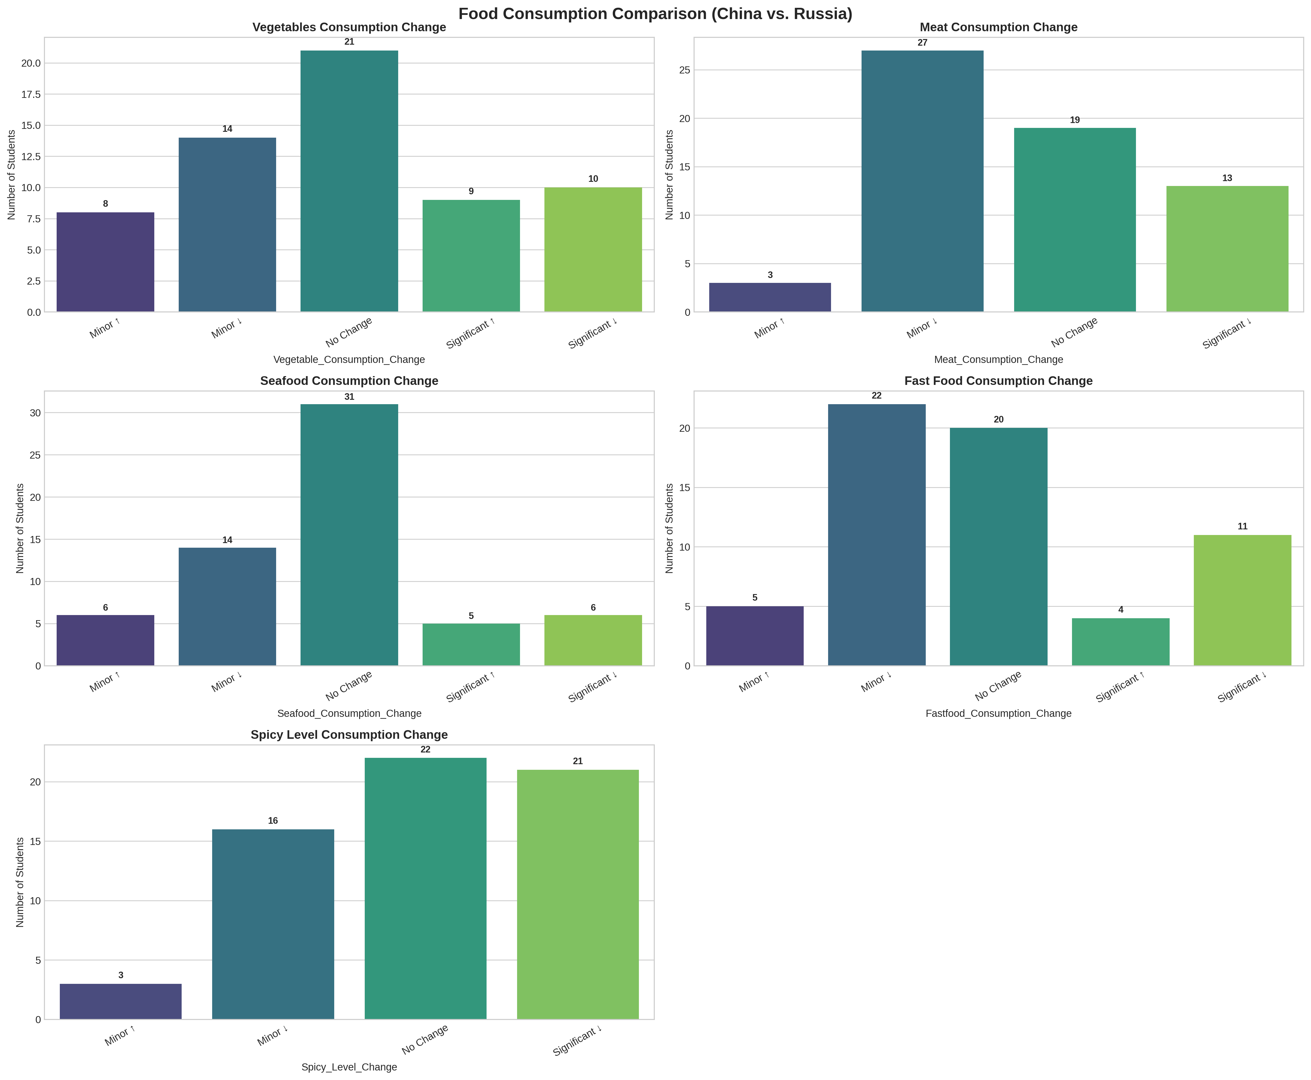
Adaptation & Weight
Diet Structure: Most students experienced Moderate to Large Changes.
Adaptation Time: Fast adaptation (<1 Month or 3-6 Months).
Weight Impact:
Unexpected result: Majority reported No Change or Weight Loss.
Contradicts the "High Calorie" assumption.
Attitude: Generally positive or neutral towards changes.
Notes:
1. 变量相关性探索：通过热力图（Heatmap）分析各变量间的线性关系。2. 关键发现：整体特征间的相关系数较低，说明饮食适应是一个受多因素影响的复杂非线性过程。3. 局部强相关：例如海鲜（Seafood）与蔬菜（Vegetable）消费变化呈现中等正相关，暗示追求健康饮食的学生往往会同时调整多类食物的摄入。这指导了我们在后续建模中选择非线性模型。
"How did these changes affect them? Image 3 reveals some surprises. Top-left: The structural change in diet was rated as 'Moderate' to 'Large' for most. However, look at the bottom-left regarding Weight Change. Despite eating more meat and fast food, most students reported 'No Change' or even 'Weight Loss.' This suggests that while the food type changed, total caloric intake might not have increased, possibly due to stress or lack of appetite for the new food."

Slide 7
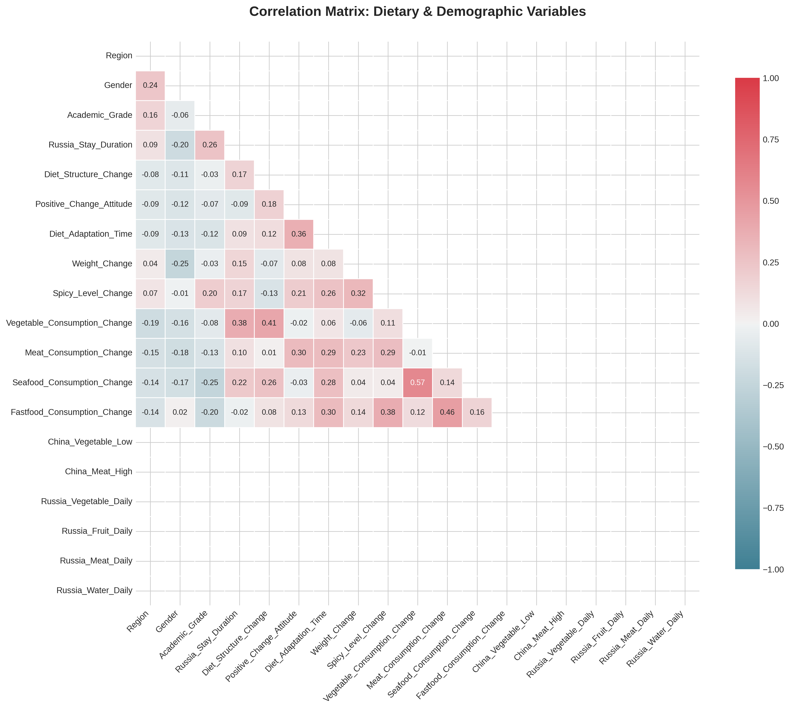
Correlation Analysis
Correlation Matrix:
Analyzed relationships between demographics and dietary habits.
Preparation: Signals potential challenges for linear regression models.
Insight: Dietary behavior is complex and subjective; not easily explained by single linear factors.
Key Finding: Weak Linear Correlations (Light colors).
Notes:
1. 任务定义：尝试使用回归模型（Regression）预测饮食改变的具体程度（Degree of Change）。
2. 模型表现：所有模型（Linear, SVR, RF, GBM）的 R^2 分数均为负数，表现不佳。
3. 原因分析（Reflection）：饮食改变程度是一个极为主观的变量（Subjective Metric），且样本量相对较小，数据中存在大量非线性噪音，导致回归模型难以拟合。这促使我们将策略转向分类任务。
"We used a Correlation Matrix (Image 5) to select features for our models. As you can see, the colors are mostly light, indicating weak linear correlations between variables. For example, 'Duration of Stay' doesn't strongly correlate with 'Diet Structure Change.' This lack of strong linearity gave us a hint that simple linear models might struggle to capture the patterns in this complex behavioral data."

Slide 8
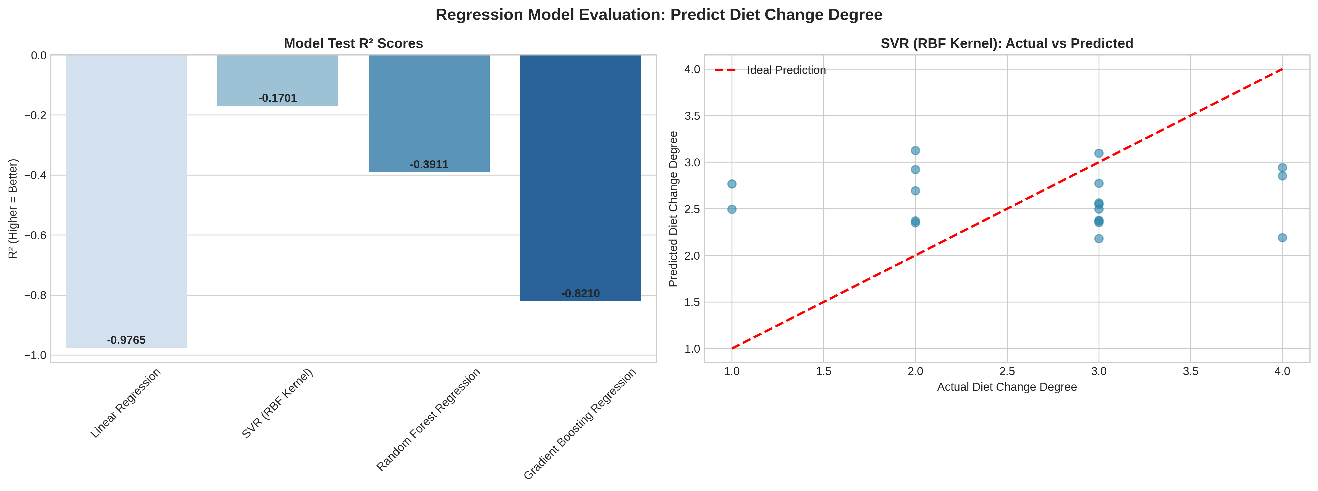
Regression Modeling
Task: Predict the specific "Degree of Diet Change" (Numerical).
Models: Linear Regression, SVR, Random Forest, Gradient Boosting.
Result: Negative R^2 Scores (Model failed to generalize).
Analysis:
Sample size constraints.
Subjective nature of the target variable (1-5 scale).
Decision: Pivot to Classification.
Notes:
1. 策略调整：将任务转换为预测学生是否持有“积极适应态度”（Positive Attitude Classification）。2. 随机森林的胜利：Random Forest Classifier 取得了最高的 AUC (0.7917)，ROC 曲线显示其具有良好的泛化能力。3. 结论：虽然很难预测具体的改变数值，但通过机器学习，我们可以有效识别出哪些特征（如留俄时长、口味偏好）最能预示一个学生能否积极适应饮食变化。
"We first attempted a Regression task to predict exactly 'how much' a student's diet would change. As shown in Image 6, the results were poor, with negative R-squared scores. The SVR plot on the right shows predicted points scattered far from the ideal red line. We analyzed this honestly: the target variable is highly subjective, and the sample size was small. Instead of forcing a bad model, we decided to pivot our strategy to a Classification task."

Slide 9
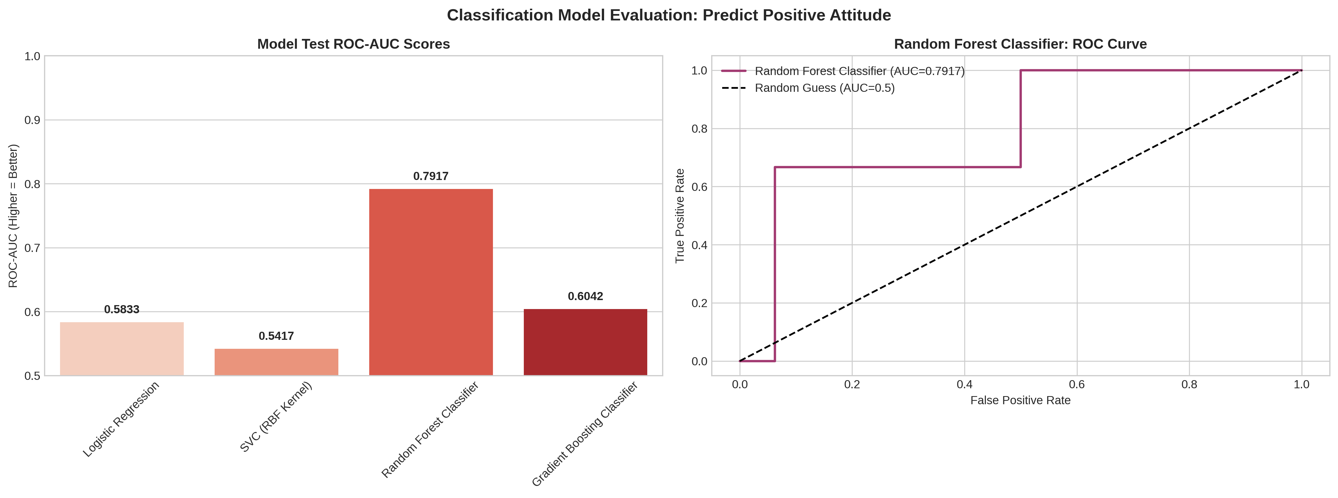
Conclusion & Limitations
New Task: Predict "Positive Attitude towards Diet" (Binary: Yes/No).
Best Model: Random Forest Classifier.
Performance:
AUC Score: 0.7917 (Strong predictive power).
Outperformed Logistic Regression & SVC.
Conclusion:
Non-linear tree models successfully captured the behavioral patterns.
Notes:
1. 关键结论：留俄学生普遍面临“少菜多肉”的挑战，适应期约为 1-3 个月；机器学习证明了适应态度是可以被预测的。
2. 局限性（Limitations）：样本量（Sample Size）受限可能影响模型的稳定性；部分问卷数据的自我报告（Self-reported）性质可能带来偏差。
3. 未来展望：建议未来的研究结合更客观的生理指标（如体检数据），并扩大样本范围以提升模型的鲁棒性。
"This pivot was successful. We redefined the problem: Can we predict if a student will have a 'Positive Attitude' towards the new diet? As seen in Image 7, the Random Forest Classifier performed excellently, achieving an AUC score of nearly 0.8. This proves that while we can't predict the exact degree of change, we can effectively identify which students are likely to adapt positively based on their dietary habits."

Slide 10
Conclusion & Reflection
01
02
03
04
Key Findings:
Model Insight:
Limitations:
Future Work:
Confirmed shift to High-Meat / Low-Veg diet.
Weight loss/maintenance is more common than weight gain.
Classification (Attitude) worked better than Regression (Degree).
Small dataset size & self-reported subjectivity.
Expand sample size & include nutritional macro-analysis.
Notes:
1. 关键结论：留俄学生普遍面临“少菜多肉”的挑战，适应期约为 1-3 个月；机器学习证明了适应态度是可以被预测的。
2. 局限性（Limitations）：样本量（Sample Size）受限可能影响模型的稳定性；部分问卷数据的自我报告（Self-reported）性质可能带来偏差。
3. 未来展望：建议未来的研究结合更客观的生理指标（如体检数据），并扩大样本范围以提升模型的鲁棒性。
"To conclude, our project confirms that Chinese students in Russia undergo significant dietary restructuring, specifically eating more meat and fewer vegetables. From a data science perspective, we learned that behavioral data is complex; while linear regression failed, Random Forest classification proved to be a powerful tool for understanding adaptation attitudes. Future work would focus on expanding our dataset to improve model robustness. Thank you."

Slide 11
Team member & contribution statement
Group AP
Presentation：Guo BoChen
Collect the data：Dang YingZhe / Hu BoYuan
Data visualizations：Dang YingZhe / Zhang Chi
Prepare the PPT slides：Peng Jianbin

Slide 12
Thank You!

